Slide 1


Linear Methods for Classification – Logistic Regression
Feb 08, 2021
CONTACT
Industrial Engineering
5th Engineering Building Room 302-4
Tel. +82 010-4818-7429
Web. http://sdm.unist.ac.kr
Notes:
Let’s continue classification as Logistic Regression next to LDA.

Slide 2
CONTENTS
1. Logistic Regression
2. Logistic Regression or LDA?
Notes:
Here are our topics today about Logistic Regression.

Slide 3
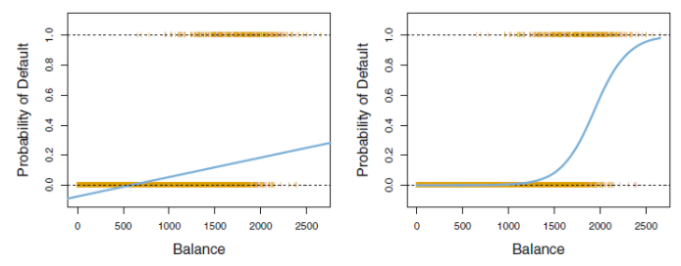
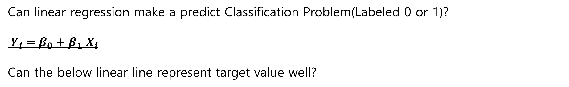
Linear Regression for Classification
Can linear regression make a predict Classification Problem(Labeled 0 or 1)?
$Y_{i}=$ $β_{0}+β_{1}$ $X_{i}$
Can the below linear line represent target value well?
Further, Let assume
there is 3-class classification Problem
- Y1=0, Y2=1, Y3=2
Notes:
Before going to begin, Let me talk about adapting Linear regression into classification.
And there is a question, ‘Can Linear Regression make a predict Classification Problem properly? ‘
The answers is No.
Because the Linear Line cannot represent truly like image.
In some points the regression line get minus value unlike our intention.
So, drawing common regression line for classification is not adequate in geometric sense.
And Let’s think about 3 classes (Y1=0, Y2=1, Y3=2).
It might be reasonable because it seems simple regression problem.
Unfortunately, it’s not as well because of Regressor model’s characteristic.
Regressor could estimate Y3 is better than Y1 because Y3 has higher Y value than Y1 unlike our intention.
So, we need to have some another perspective resolving classification problem.

Slide 4
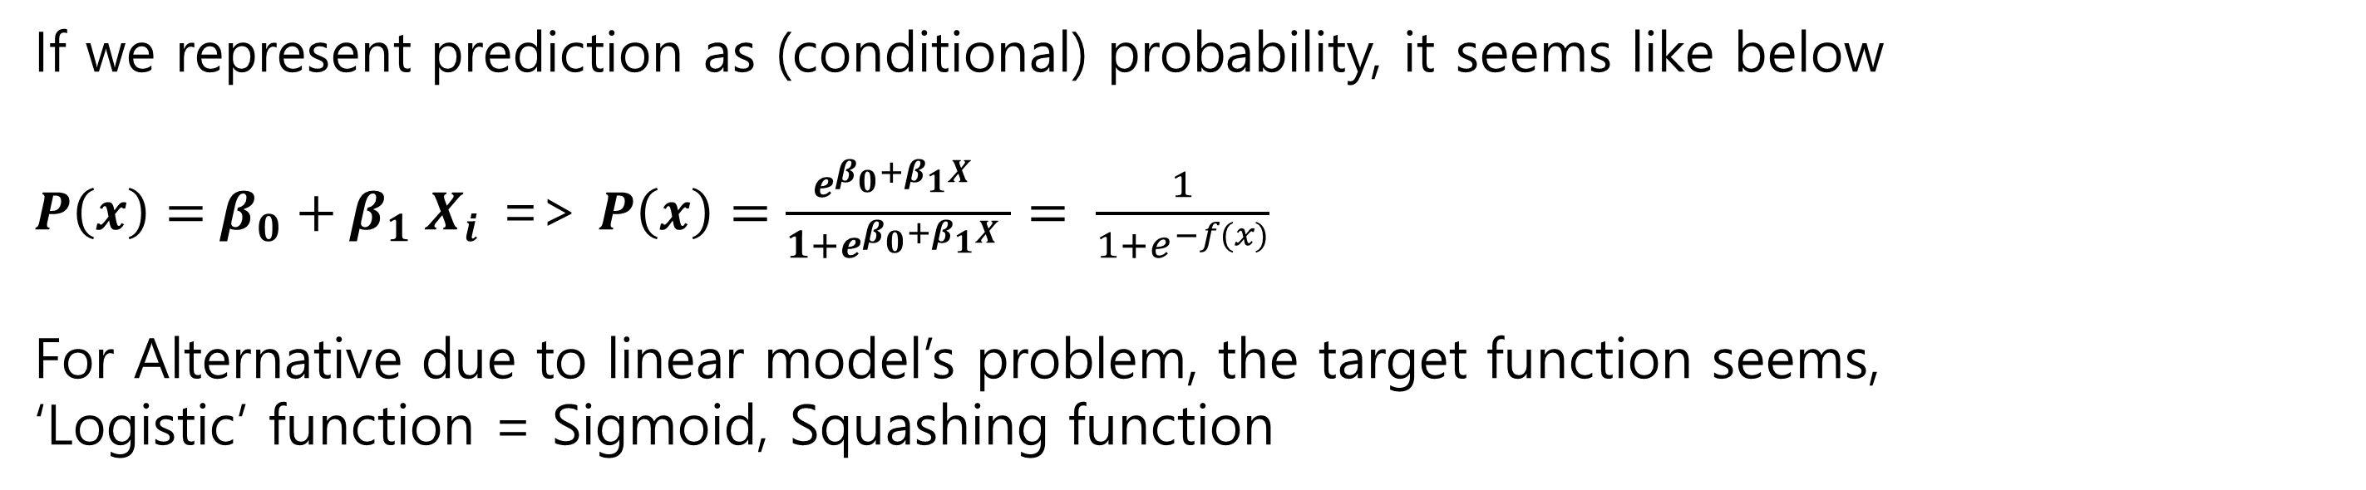
Logistic Regression
If we represent prediction as (conditional) probability, it seems like below
$P\left(x\right)=$ $β_{0}+β_{1}$ $X_{i}$ => $P\left(x\right)=\frac{e^{β_{0}+β_{1}X }}{1+e^{β_{0}+β_{1}X }}= \frac{1}{1+e^{−f(x)}}$
For Alternative due to linear model’s problem, the target function seems,
‘Logistic’ function = Sigmoid, Squashing function
Notes:
The perspective commented before is using conditional probability for classification problem.
Make our prediction goal is getting probability f(x) what takes specific category.
And there is sample problem although it’s represented by conditional probability.
If we use probability by origin linear function like left, there are points have negative value and value beyond 1 in the contrast.
For resolving it, we need to replace negative value to 0 and value beyond 1 to 1.
However, this situation when it converges boundary value completely could not occur in real world.
So, we need to handle those limitation for classification.
The answer is that takes Logistic Function to our linear equation.
Logistic function has advantage to overcome the Limitations.

Slide 5
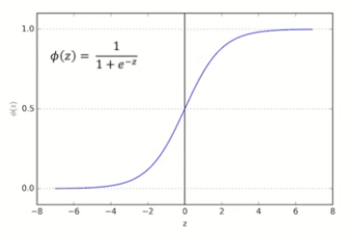
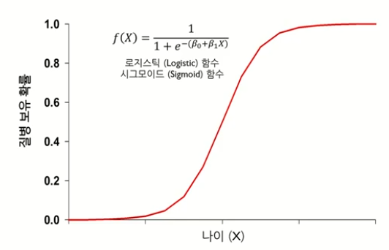
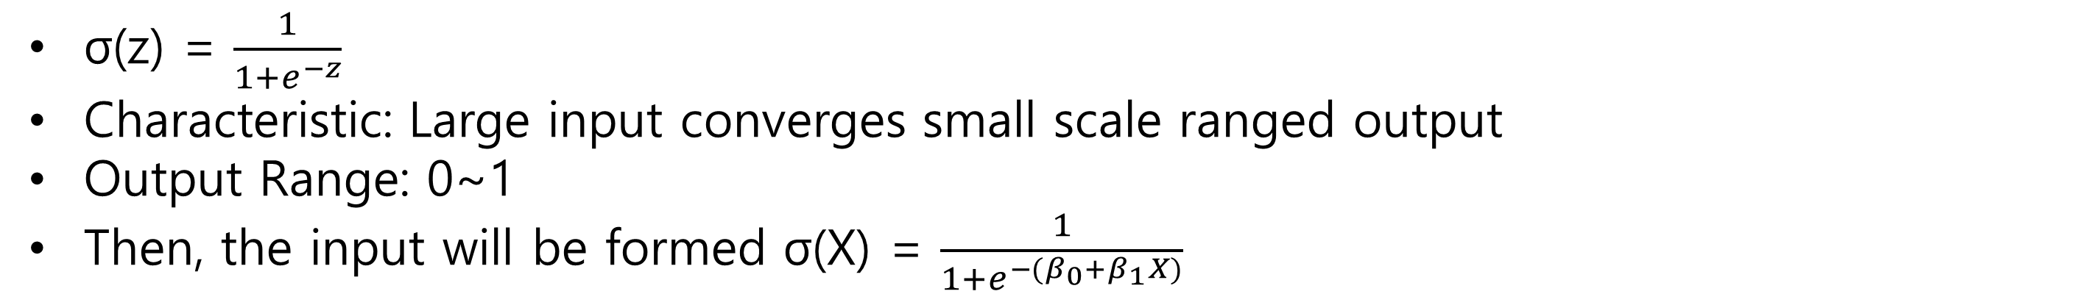
Logistic Function
σ(z) = $\frac{1}{1+e^{−z}}$
Characteristic: Large input converges small scale ranged output
Output Range: 0~1
Then, the input will be formed σ(X) = $\frac{1}{1+e^{−(β_{0}+β_{1}X)}}$
Notes:
This page is general description about Logistic Function.
Let we just focus Logistic Function covering our linear equation like right image.
It could be thought non-linear variable combinations unlike linear model previously.
So, we could not get coefficient in simple way.
For resolving this, Look another notion called logit and Log Odds Transformation.

Slide 6
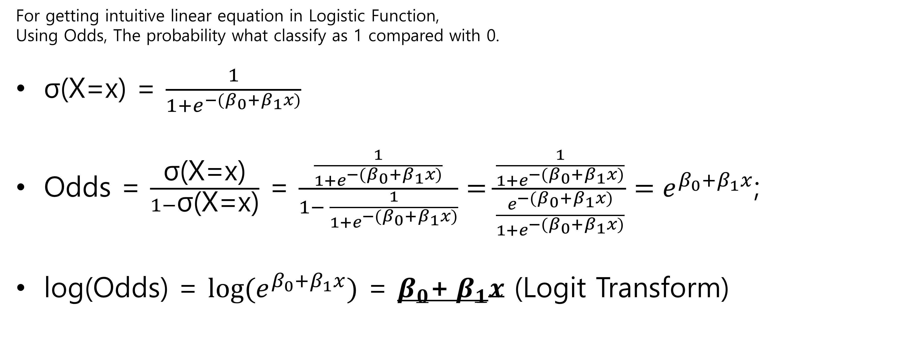
Odds
For getting intuitive linear equation in Logistic Function,
Using Odds, The probability what classify as 1 compared with 0.
σ(X=x) = $\frac{1}{1+e^{−(β_{0}+β_{1}x)}}$
Odds = $\frac{\text{σ}\text{(}\text{X}\text{=}\text{x}\text{)}}{1−\text{σ}\text{(}\text{X}\text{=}\text{x}\text{)}}$ = $\frac{\frac{1}{1+e^{−(β_{0}+β_{1}x)}}}{1− \frac{1}{1+e^{−(β_{0}+β_{1}x)}}}=\frac{\frac{1}{1+e^{−(β_{0}+β_{1}x)}}}{\frac{e^{−(β_{0}+β_{1}x)}}{1+e^{−(β_{0}+β_{1}x)}}}=e^{β_{0}+β_{1}x}$;
log(Odds) = $log(e^{β_{0}+β_{1}x})$ = $β_{0}$+ $β_{1}x$ (Logit Transform)
Notes:
The reason why we take odds is to check relationship between probability(p(x)) and independent variable(x) when determinant function(p) is non-linear.
Before changing linear function, let us know Odds first.
Odds is the probability what classify as 1 compared with 0.
If we set the probability sigma(X=x) is probability to classify as 1, then classify as 0 is 1-sigma(X=x).
So We could show Odds as $\frac{\text{σ}\text{(}\text{X}\text{=}\text{x}\text{)}}{1−\text{σ}\text{(}\text{X}\text{=}\text{x}\text{)}}$ = $\frac{\frac{1}{1+e^{−(β_{0}+β_{1}x)}}}{1− \frac{1}{1+e^{−(β_{0}+β_{1}x)}}}$ $=\frac{\frac{1}{1+e^{−(β_{0}+β_{1}x)}}}{\frac{e^{−(β_{0}+β_{1}x)}}{1+e^{−(β_{0}+β_{1}x)}}}=e^{β_{0}+β_{1}x}$
And take log on Odds, then we could see linear equation like $β_{0}$+ $β_{1}x$ .
Logistic Regression has linear relationship between X and logit unlike general linear regression.
If x increases, the odds $\frac{\text{σ}\text{(}\text{X}\text{=}\text{x}\text{)}}{1−\text{σ}\text{(}\text{X}\text{=}\text{x}\text{)}}$ increases $e^{β_{1}}$.
We define Logistic function for representing classification output as probability. As we handled before, Logistic Function is represented non-linear combination. So we need to convert it in Intuitive way using Odds and log-odds transformation called logit transformation.

Slide 7
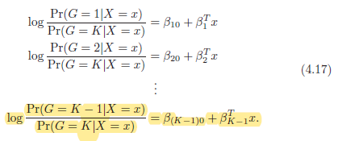
Extent to Multi-Classes
Notes:
And return to equation 4.17 with knowledge about odds.
In Multi-Class Classification problem, Logistic Regression could represent like above.
The reason why I make a explain background of logit(log odds) transformation before looking at Logistic Regression’s basic equation.

Slide 8
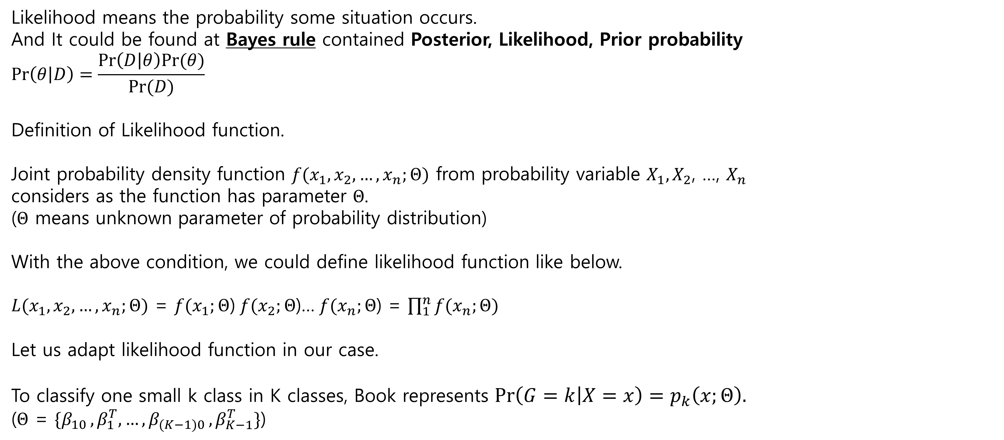
Likelihood
Likelihood means the probability some situation occurs.
And It could be found at Bayes rule contained Posterior, Likelihood, Prior probability
$$Pr\left(θ | D\right)=\frac{Pr\left(D | θ\right)Pr(θ)}{Pr(D)}$$
Definition of Likelihood function.
Joint probability density function $f(x_{1},x_{2},…,x_{n};Θ)$ from probability variable $X_{1},X_{2}$, …, $X_{n}$
considers as the function has parameter $Θ$.
($Θ$ means unknown parameter of probability distribution)
With the above condition, we could define likelihood function like below.
$L(x_{1},x_{2},…,x_{n};Θ)$ = $f(x_{1};Θ$) $f(x_{2};Θ$)… $f(x_{n};Θ$) = $\prod_{1}^{n}{f(x_{n};Θ)}$
Let us adapt likelihood function in our case.
To classify one small k class in K classes, Book represents $\operatorname{Pr}\left(G=k | X=x\right)=p_{k}\left(x;Θ\right).$
($Θ$ = $\{β_{10 }, β_{1}^{T},…,β_{(K−1)0 }, β_{K−1}^{T}\}$)
Notes:
And, Before expanding 3 class problem, we need to know about likelihood first.
Maybe We need to use any estimation indicator like least-square method.
But, in Logistic Regression, we gonna use MLE(Maximum Likelihood Estimation) method.
The reason why it uses maximum likelihood unlike least square is prediction value is probability.
And MLE is good for fitting non-linear model.
You guys might see likelihood when we handle bayes’ rule in LDA.
Likelihood is the probability some situation occurs.
And It appear for calculating posterior probability[$Pr\left(θ | D\right)$] by likelihood[$Pr\left(D | θ\right)$] and prior probability[$Pr(θ)$]
$$Pr\left(θ | D\right)=\frac{Pr\left(D | θ\right)Pr(θ)}{Pr(D)}$$
In other words, it is the probability when we could get using observation data.
In most dataset, the datapoints at row are independent so the Likelihood function could be showed by multiplication of each datapoint.
And let we adapt this concept to our classification like below.
And here is formal definition of likelihood function.
If Likelihood could be defined like above, let we adapt it into our case.

Slide 9
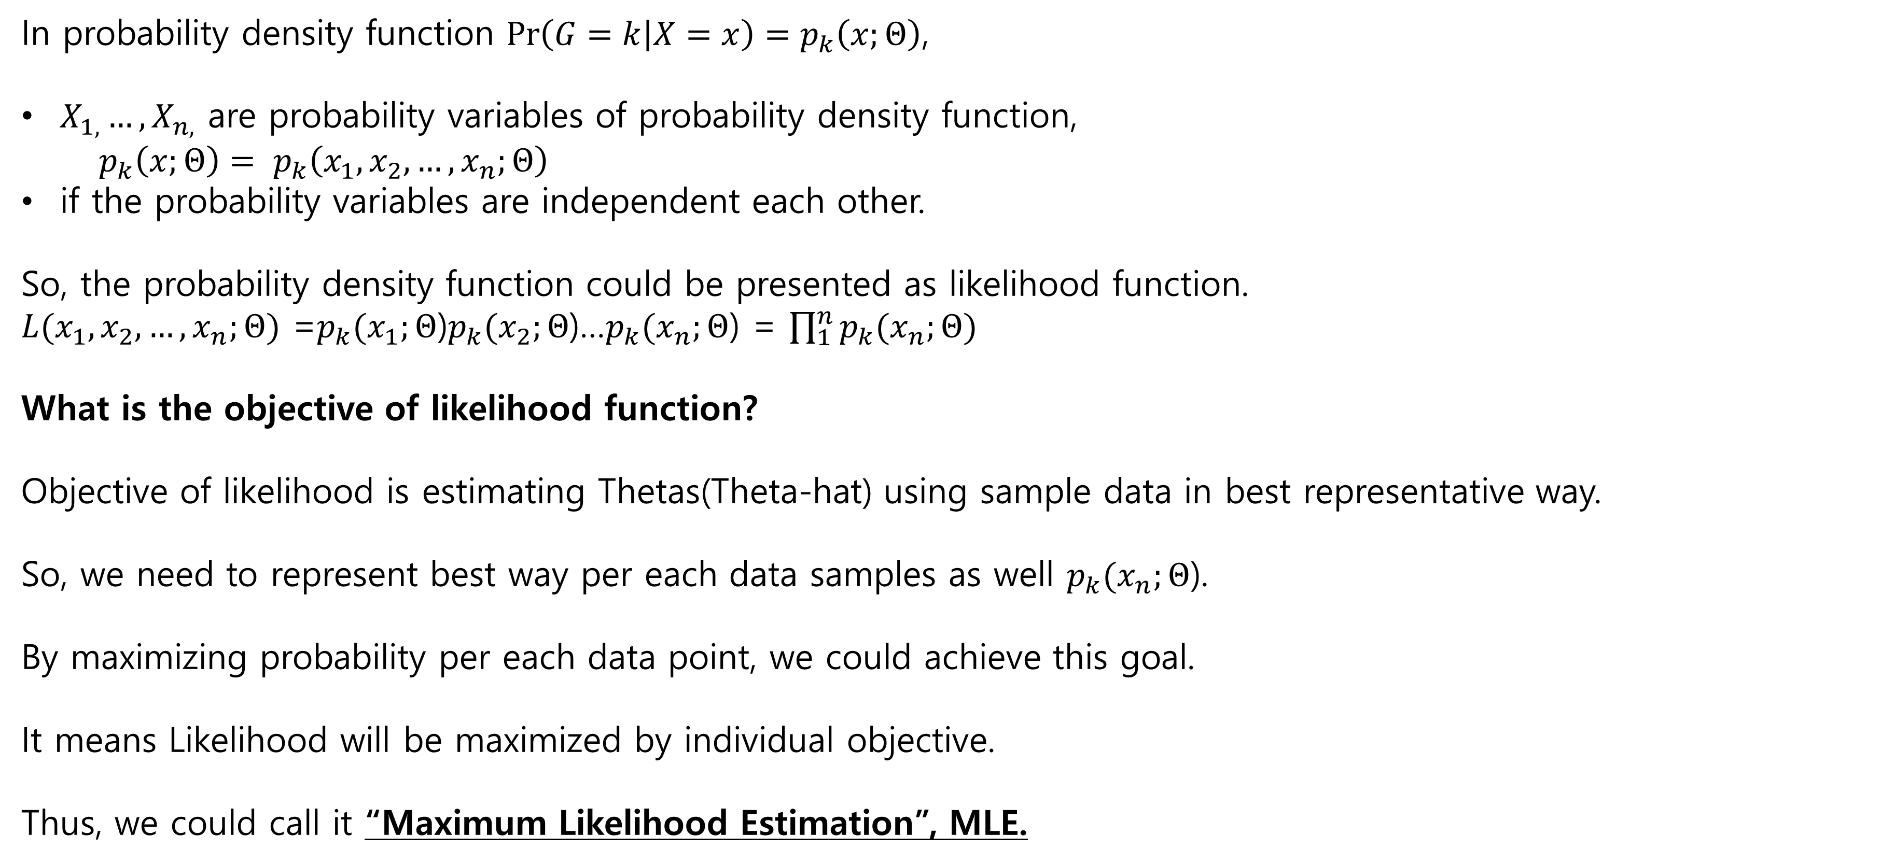
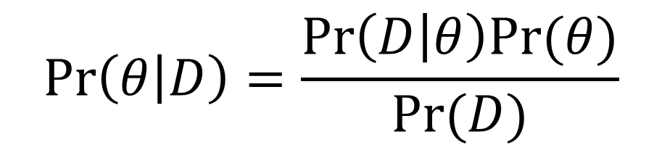
Likelihood
In probability density function $\operatorname{Pr}\left(G=k | X=x\right)=p_{k}\left(x;Θ\right)$,
$X_{1,}…,X_{n,}$ are probability variables of probability density function,
$${p_{k}\left(x;Θ\right)= p}_{k}\left(x_{1},x_{2},…,x_{n};Θ\right)$$
if the probability variables are independent each other.
So, the probability density function could be presented as likelihood function.
$L(x_{1},x_{2},…,x_{n};Θ)$ =$p_{k}(x_{1};Θ$)$p_{k}(x_{2};Θ$)…$p_{k}(x_{n};Θ$) = $\prod_{1}^{n}{p_{k}(x_{n};Θ)}$
What is the objective of likelihood function?
Objective of likelihood is estimating Thetas(Theta-hat) using sample data in best representative way.
So, we need to represent best way per each data samples as well $p_{k}(x_{n};Θ$).
By maximizing probability per each data point, we could achieve this goal.
It means Likelihood will be maximized by individual objective.
Thus, we could call it “Maximum Likelihood Estimation”, MLE.
$$Pr\left(θ | D\right)=\frac{Pr\left(D | θ\right)Pr(θ)}{Pr(D)}$$
Notes:
Our probability density function can be represented like it because what becomes different by Thetas due to that it’s different by probability variable.
And it is joint probability density function because probability variable is independent.
Thus, the likelihood of it figures out like above
Then How could we make good Logistic Regression model using likelihood function?
For that, let us think about the equation for posterior probability.
$$Pr\left(θ | D\right)=\frac{Pr\left(D | θ\right)Pr(θ)}{Pr(D)}$$
The first objective is to get posterior probability using likelihood and prior probability.
Then what is the objective of likelihood.
It could be figuring out best representative prob using sample data.
‘best’ means getting high probability per sample data.
Then each probability density function becomes maximize then the likelihood becomes maximize.
So, we could say we have to maximize likelihood function.
It’s called MLE.

Slide 10
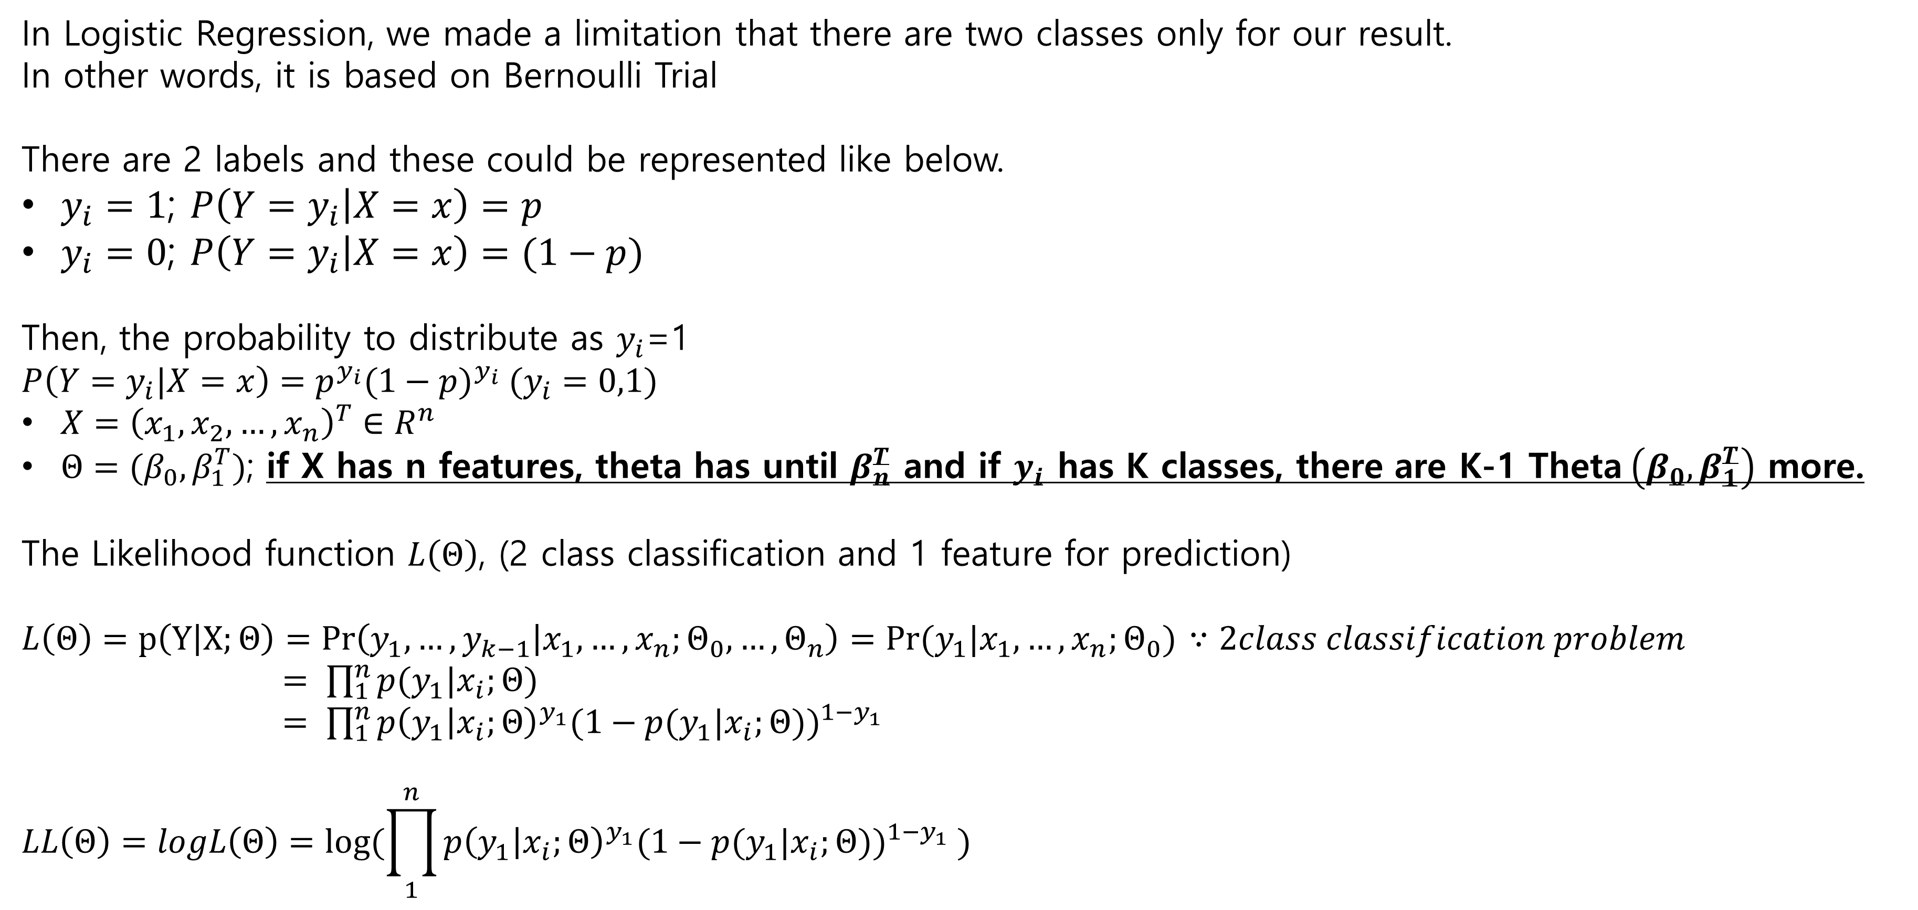
Likelihood – 2class
In Logistic Regression, we made a limitation that there are two classes only for our result.
In other words, it is based on Bernoulli Trial
There are 2 labels and these could be represented like below.
$y_{i}=1$; $P\left(Y=y_{i} | X=x\right)=p$
$y_{i}=0$; $P\left(Y=y_{i} | X=x\right)=(1−p)$
Then, the probability to distribute as $y_{i}$=1
$$P\left(Y=y_{i}|X=x\right)=p^{y_{i}}{(1−p)}^{y_{i}} (y_{i}=0,1)$$
$X={\left(x_{1},x_{2},…,x_{n}\right)}^{T}∈R^{n}$
$Θ=(β_{0},β_{1}^{T})$; if X has n features, theta has until $β_{n}^{T}$ and if $y_{i}$ has K classes, there are K-1 Theta$\left(β_{0},β_{1}^{T}\right)$ more.
The Likelihood function $L\left(Θ\right)$, (2 class classification and 1 feature for prediction)
$L\left(Θ\right)=p\left(Y | X;Θ\right)=Pr\left(y_{1},…,y_{k−1} | x_{1},…,x_{n};Θ_{0},…,Θ_{n}\right)=Pr(y_{1}|x_{1},…,x_{n};Θ_{0})$ $∵2class classification problem$
$= \prod_{1}^{n}{p(y_{1}|x_{i};Θ)}$
$= \prod_{1}^{n}{{p\left(y_{1} | x_{i};Θ\right)}^{y_{1}}{(1−p(y_{1}|x_{i};Θ))}^{1−y_{1}} }$
$$LL\left(Θ\right)=logL\left(Θ\right)=log⁡(\prod_{1}^{n}{{p\left(y_{1} | x_{i};Θ\right)}^{y_{1}}{(1−p(y_{1}|x_{i};Θ))}^{1−y_{1}} })$$
Notes:
And one more step before looking at multiple classes is watching 2 class problem first.
If we make a limitation there are only 2 classes in classification problem, it could be defined Bernoulli Trial.
So, if we set probability p of label number 1, 1-p as label number 0.
Then, the probability density function of 2classes seems like p power yi multiply 1-p power yi.
One more step forward to 3 classes classification, The Thetas will be 2. for class 0 and 1.
And, If we have p dimensional features, there are p+1 betas in one Theta.
Returning to 2 class example again, let we see likelihood function equation at the bottom side.
Then, log is taken at the likelihood function.
So we call it log likelihood function. Then why we take log at the likelihood function?

Slide 11

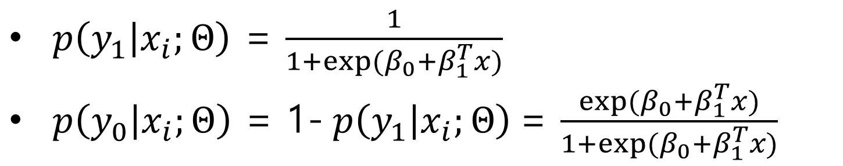
Log likelihood– 2classes
Takes Log at likelihood function,
$$LL\left(Θ\right)=logL\left(Θ\right)=log⁡(\prod_{1}^{n}{{p\left(y_{1} | x_{i};Θ\right)}^{y_{1}}{(1−p(y_{1}|x_{i};Θ))}^{1−y_{1}} })$$
Why do we need to take a log at likelihood function?
$$LL\left(Θ\right)= \sum_{i=1}^{N}{\{y_{1}logp\left(y_{1} | x_{i};Θ\right)+\left(1−y_{1}\right)log⁡(1−p\left(y_{1} | x_{i};Θ\right))\}}$$
$$=\sum_{i=1}^{N}{\{y_{1}logp\left(y_{1} | x_{i};Θ\right)−y_{1}log⁡(1−p\left(y_{1} | x_{i};Θ\right))+log⁡(1−p\left(y_{1} | x_{i};Θ\right))\}}$$
$$=\sum_{i=1}^{N}{\{y_{1}log\frac{p\left(y_{1} | x_{i};Θ\right)}{1−p\left(y_{1} | x_{i};Θ\right)}+log⁡(1−p\left(y_{1} | x_{i};Θ\right))\}}$$
$$=\sum_{i=1}^{N}{\{y_{1}Θ^{T}x_{i}−log⁡(1+e^{Θ^{T}x_{i}})\}}$$
$p\left(y_{1} | x_{i};Θ\right)$ = $\frac{1}{1+exp⁡(β_{0}+β_{1}^{T}x)}$
$p\left(y_{0} | x_{i};Θ\right)$ = 1- $p\left(y_{1} | x_{i};Θ\right)$= $\frac{exp⁡(β_{0}+β_{1}^{T}x)}{1+exp⁡(β_{0}+β_{1}^{T}x)}$
Notes:
Q. Why takes log at the likelihood function?
https://www.quora.com/Why-do-we-always-put-log-in-Maximum-Likelihood-estimation-before-estimate-the-parameter
By dealing with summation instead of multiplication, it’s more convenient.
i.e. likelihood without log would be needed additional steps for objective function.
The answer is that it’s more convenient by dealing with summation instead of multiplication.
So, it is equation 4.20 and I added one more line in the development of this equation.

Slide 12
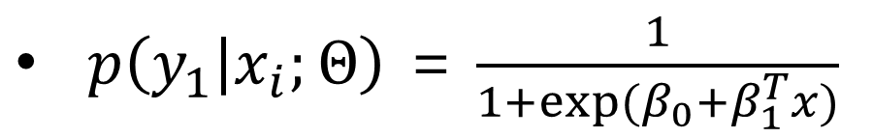
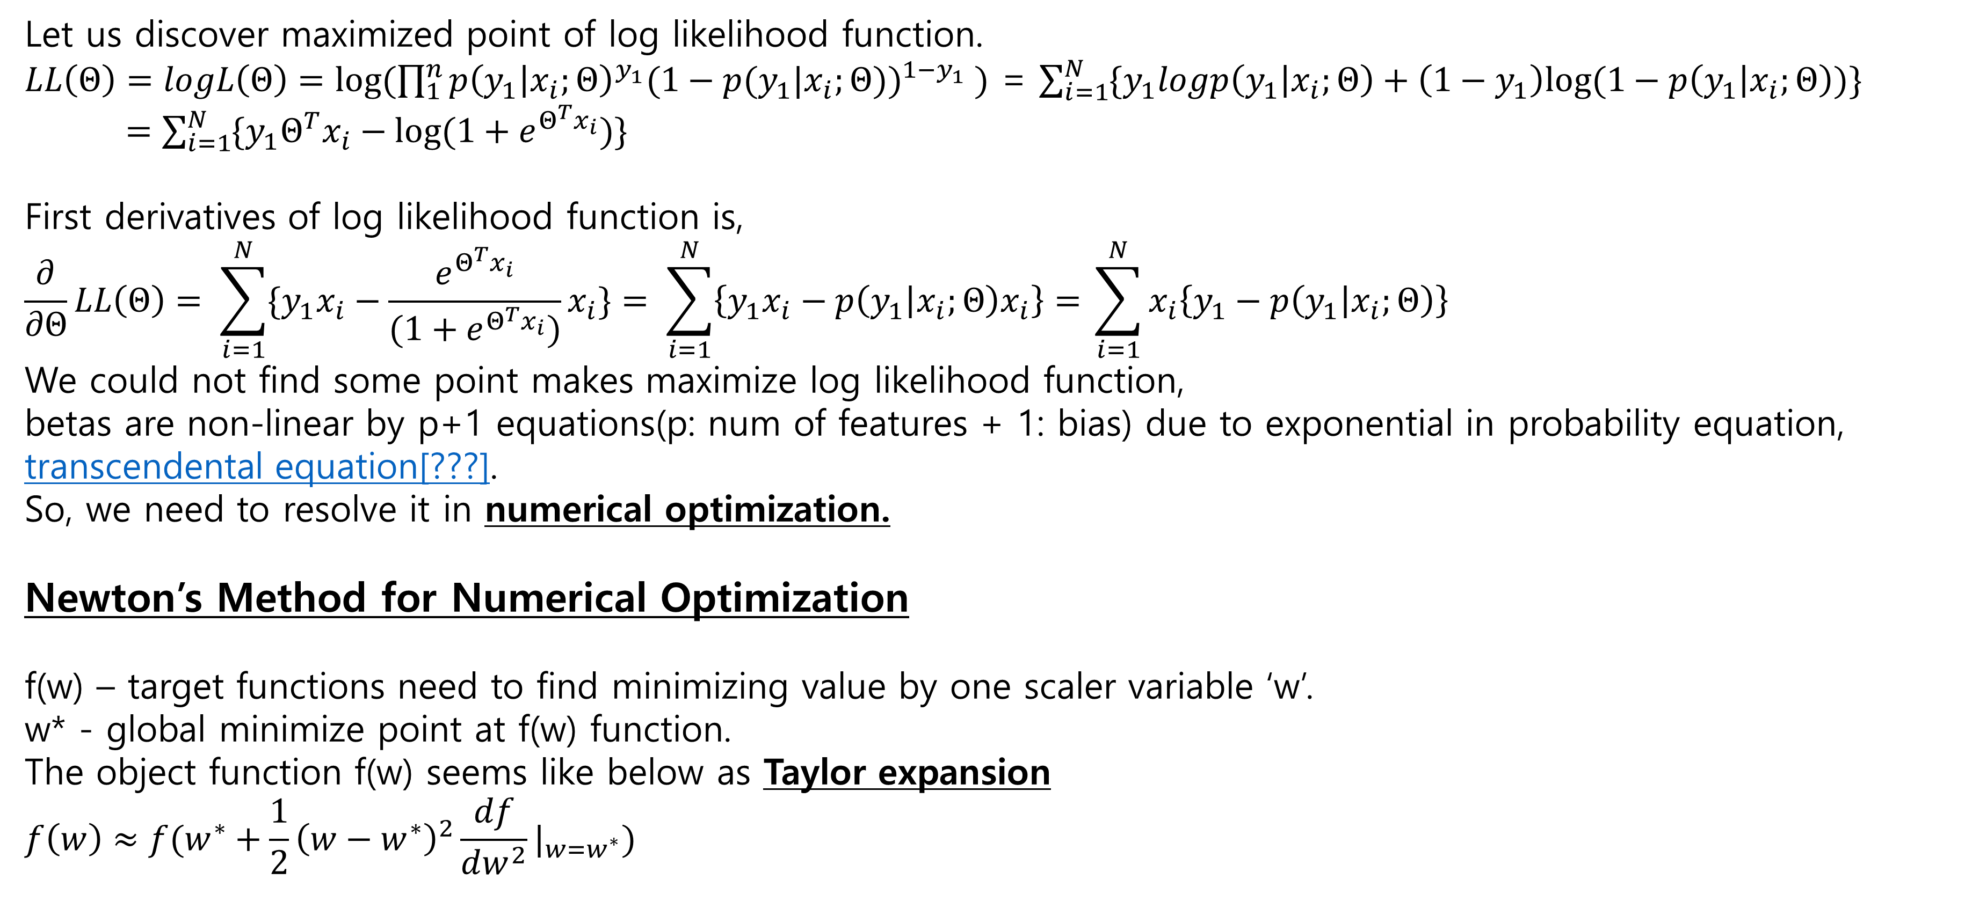
Newton’s Method
Let us discover maximized point of log likelihood function.
$LL\left(Θ\right)=logL\left(Θ\right)=log⁡(\prod_{1}^{n}{{p\left(y_{1} | x_{i};Θ\right)}^{y_{1}}{(1−p(y_{1}|x_{i};Θ))}^{1−y_{1}} })$ = $\sum_{i=1}^{N}{\{y_{1}logp\left(y_{1} | x_{i};Θ\right)+\left(1−y_{1}\right)log⁡(1−p\left(y_{1} | x_{i};Θ\right))\}}$
$=\sum_{i=1}^{N}{\{y_{1}Θ^{T}x_{i}−log⁡(1+e^{Θ^{T}x_{i}})\}}$
First derivatives of log likelihood function is,
$$\frac{∂}{∂Θ}LL\left(Θ\right)= \sum_{i=1}^{N}{\{y_{1}x_{i}−\frac{e^{Θ^{T}x_{i}}}{(1+e^{Θ^{T}x_{i}})}x_{i}\}}= \sum_{i=1}^{N}{\left\{y_{1}x_{i}−p\left(y_{1} | x_{i};Θ\right)x_{i}\right\}= }\sum_{i=1}^{N}{x_{i}\left\{y_{1}−p\left(y_{1} | x_{i};Θ\right)\right\} }$$
We could not find some point makes maximize log likelihood function,
betas are non-linear by p+1 equations(p: num of features + 1: bias) due to exponential in probability equation, transcendental equation[???].
So, we need to resolve it in numerical optimization.
Newton’s Method for Numerical Optimization
f(w) – target functions need to find minimizing value by one scaler variable ‘w’.
w* - global minimize point at f(w) function.
The object function f(w) seems like below as Taylor expansion
$$f\left(w\right)≈f(w^{∗}+\frac{1}{2}{\left(w−w^{∗}\right)}^{2}\frac{df}{dw^{2}}|_{w=w^{∗}})$$
$p\left(y_{1} | x_{i};Θ\right)$ = $\frac{1}{1+exp⁡(β_{0}+β_{1}^{T}x)}$
※ ‘Taylor expansion’
It is for representing unknown objective function as approximative polynomial equation at specific point.
Notes:
Now, we need to find the specific point where it makes maximize log likelihood function.
Unfortunately, we could not get closed-form at the first derivatives of LL function because the fraction of function ‘$p\left(y_{1} | x_{i};Θ\right)$’ is nonlinear combination of Theta $\frac{1}{1+exp(β_{0}+β_{1}^{T}x)}$.
For figuring out optimal point in this situation, we gonna use numerical optimization.
There are many numerical optimization way, however, we handle Newton’s Method like our textbook.
Let us talk about it via simple example of the reference.
According to this optimization method, there is second derivatives of function unlike common way to find optimal point before.

Slide 13
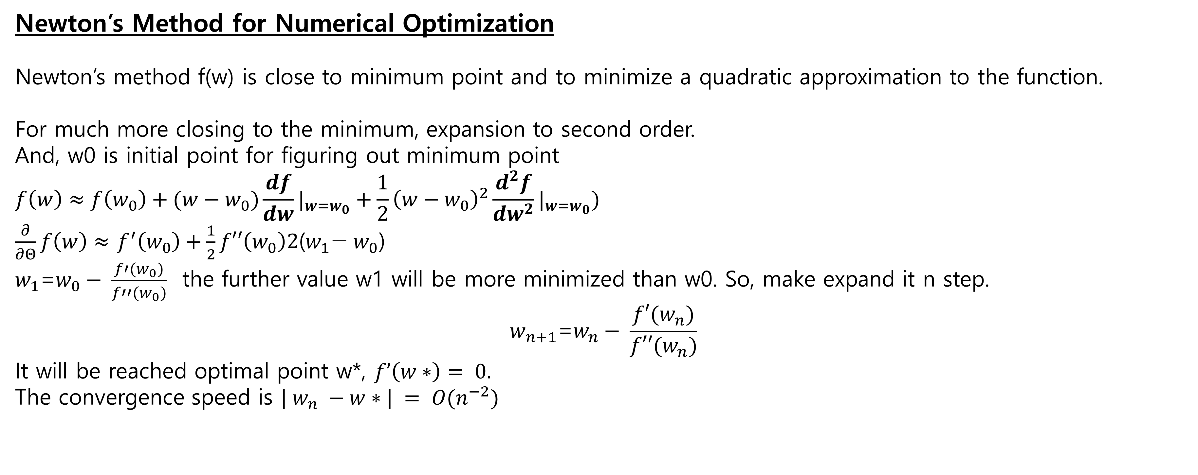
Newton’s Method
Newton’s Method for Numerical Optimization
Newton’s method f(w) is close to minimum point and to minimize a quadratic approximation to the function.
For much more closing to the minimum, expansion to second order.
And, w0 is initial point for figuring out minimum point
$$f\left(w\right)≈f\left(w_{0}\right)+(w−w_{0})\frac{df}{dw}|_{w=w_{0}}+\frac{1}{2}{\left(w−w_{0}\right)}^{2}\frac{d^{2}f}{dw^{2}}|_{w=w_{0}})$$
$\frac{∂}{∂Θ}f\left(w\right)≈$ $f^{′}\left(w_{0}\right)+\frac{1}{2}f′′\left(w_{0}\right)2\text{(}w_{1}\text{−} w_{0}\text{)}$
$w_{1}\text{=}w_{0}− \frac{f′(w_{0})}{f′′(w_{0})}$ the further value w1 will be more minimized than w0. So, make expand it n step.
$$w_{n+1}\text{=}w_{n}− \frac{f′(w_{n})}{f′′(w_{n})}$$
It will be reached optimal point w*, $f’\left(w∗\right)= 0.$
The convergence speed is $| w_{n} −w∗| = O(n^{−2})$
Notes:
For the more detailed approximation, Taylor expansion expand second order like first line of equation on this page.
Then we take derivative as w after first/second derivative replace with $f′$ and $f′$’.
Then we could get the next transition point via newton’s method like $w_{n+1}\text{=}w_{n}− \frac{f′(w_{n})}{f′′(w_{n})}$
If you keep repeating until when some threshold(difference btw two points) reached, we could find optimal point where makes minimize our function.

Slide 14


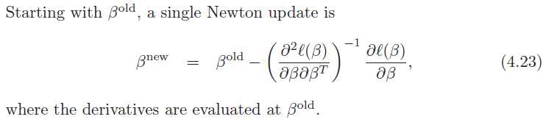
Newton-Raphson Method (Iteratively Reweighted Least Squares Method; IRLS)
Notes:
And it is the figure and the equation what adapted our problem.
The previous slide about this sounds like weird, however, you could adapt it in simple if you understand well.
Just use first and second derivatives for figuring out next point what find minimize point.
It’ called Iteratively Reweighted Least Squares Method; IRLS due to that it finds the point in iterable way.

Slide 15
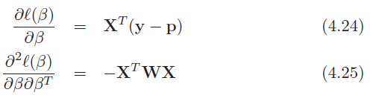
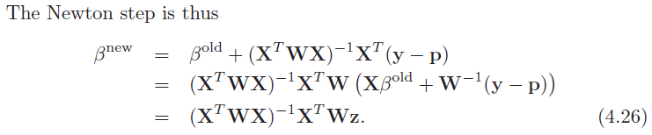
Newton-Raphson Method (Iteratively Reweighted Least Squares Method; IRLS)
Notes:
The result could represent in simple as matrix.
y: vector for yi values.
X: N x (p+1) matrix for xi values.
p: fitted prob i-th element; p(xi; beta-old)
W: N x N diagonal matrix for i-th element’s weight; p(xi; beta-old)(1-p(xi; beta-old))
If eq 4.23 developed by eq 4.24 and eq 4.25, eq 4.26 could be derived.
In eq 4.26, if Xbeta-old + W^-1(y-p) replaced with eq 4.27, it could be presented beta-new as weighted least square.
(z as response variable, W as weight matrix).
So, That’s because this way is estimating betas in iterative way, it’s called Iteratively Reweighted Least Squares Method.

Slide 16
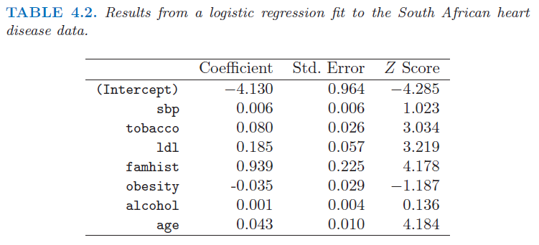
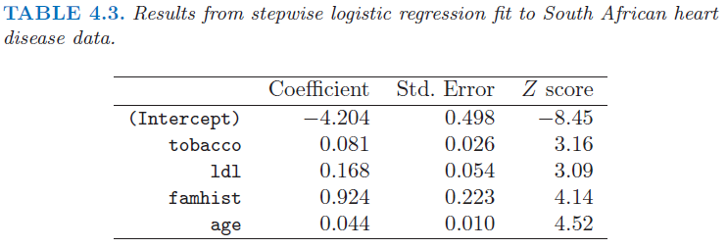
Example – South African heart disease data
Z-scores per coefficient stand for checking significance.
The null hypothesis(H0) is the coefficient needs to be dropped at 5% level significant.
The Z-score will be 2 in absolute value.
So, ‘sbp’, ‘obseity’, and ‘alcohol’, are dropped in one step further from the first
Notes:
If eq 4.23 developed by eq 4.24 and eq 4.25, eq 4.26 could be derived.
In eq 4.26, if Xbeta-old + W^-1(y-p) replaced with eq 4.27, it could be presented beta-new as weighted least square.
(z as response variable, W as weight matrix).
So, That’s because this way is estimating betas in iterative way, it’s called Iteratively Reweighted Least Squares Method.

Slide 17

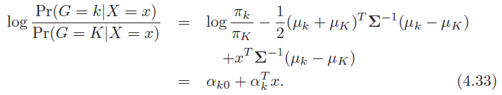
Logistic Regression or LDA?
Logistic Regression
LDA (Linear Discriminant Analysis)
For estimating parameters,
there is no assumption just estimate the way of maximizing likelihood value
More generalized method
For estimating parameters,
there are some assumptions like ‘class density’, ‘pooled variance btw classes’
Fewer flexible than Logistic Regression Method
Result
Logistic Regression model is more robust than LDA due to no assumption.
But, if dataset has some properties what LDA assumptions have, using LDA is much more efficient to estimate by adapting assumptions.
Notes:
LDA could be represented linear due to constraints what we discussed before. There are classes density function follows Gaussian Distribution and classes variance are same as pooled variance.
And Logistic Regression also can be showed as linear model via logit transformation.
The common point is that these could be presented as linear model, however, The difference is how to fit the linear line.
We could say Logistic Regression is more generalized method than LDA because there are few constraints in Logistic Regression.
By taking more constraints in LDA, we could get more information during estimating parameters and estimate those in efficient way.
i.e. If Sample follows Gaussian Distribution, There are increasing 30% efficiency compared with not followed it. And it means it doesn’t need 30% sample data more.
However, the constraints what has pooled variance could occur case not robust in outlier datapoint

Slide 18
References
Logistic Regression
Eng - A Gentle Introduction to Logistic Regression With Maximum Likelihood Estimation
Eng - Classification 2: Linear discriminant analysis(continued); logistic Regression
Eng - Classification 3: Logistic Regression(continued); model-free classification
Kor - [ISL] 4장 - 분류(로지스틱, LDA, QDA) 이해하기
Kor - 로지스틱회귀 파라메터 추정
Kor - 04. logistic regression ( 로지스틱 회귀 )
Kor - [머신러닝] Logistic Regression(MLE와 Bayesian inference를 통한 확률론적 접근)
Kor - [확률과 통계] 53. 통계적추정(2) – 점 추정(최대우도 추정), Point Estimation(Maximum Likelihood Method)
Kor – [확률과 통계] 100. 우도(가능도)함수, likelihood Function
Newton’s Method
Eng - Logitic Regression and Newton’s Method
Kor - Logistic Regression
Kor - 테일러 급수의 이해와 활용 (Tayer series)
Kor - 뉴턴법/뉴턴-랩선법의 이해와 활용(Newton’s method)
Notes:
LDA could be represented linear due to constraints what we discussed before. There are classes density function follows Gaussian Distribution and classes variance are same as pooled variance.
And Logistic Regression also can be showed as linear model via logit transformation.
The common point is that these could be presented as linear model, however, The difference is how to fit the linear line.
We could say Logistic Regression is more generalized method than LDA because there are few constraints in Logistic Regression.
By taking more constraints in LDA, we could get more information during estimating parameters and estimate those in efficient way.
i.e. If Sample follows Gaussian Distribution, There are increasing 30% efficiency compared with not followed it. And it means it doesn’t need 30% sample data more.
However, the constraints what has pooled variance could occur case not robust in outlier datapoint

Slide 19
THANK YOU

